Slide 1
CSCE 623 In Class Day 05
Synchronous session

Slide 2
Agenda for Day 05
Activity (worksheet) Model Fit, Bias and variance
Review key concepts for supervised ML
Activity: Class Project Risk Reduction: ML question & Data
Review key concepts for linear regression
In class activity (Gradient Descent Worksheet)
Discuss post class coding gradient-descent activity (pre-Day-6)
Questions & Dismissal

Slide 3
Activity: Evaluating Models, Model Flexibility, Bias and Variance (Worksheet)
Instructor will provide directions on completing the worksheet:
Work on Questions 1-4 individually for 5 min
Instructor will create breakout groups
Review questions 1-4 with peers
Work on Q5-8 as a team
Return from breakout group – be prepared to answer instructor questions from Q1-8

Slide 4
Key concepts for Supervised ML
Quality of Fit
Model Flexibility
Bias-Variance Tradeoff

Slide 5

Supervised ML Quality of fit
Given a model which makes predictions of labels ($\hat{y}$) from observations X and knowledge of the correct labels ($y$), determine goodness of fit as a single numerical value

Slide 6

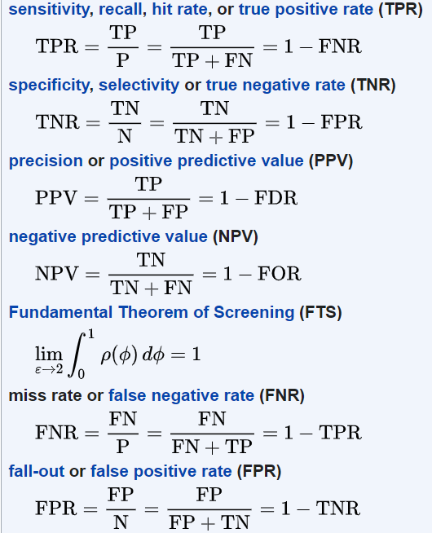
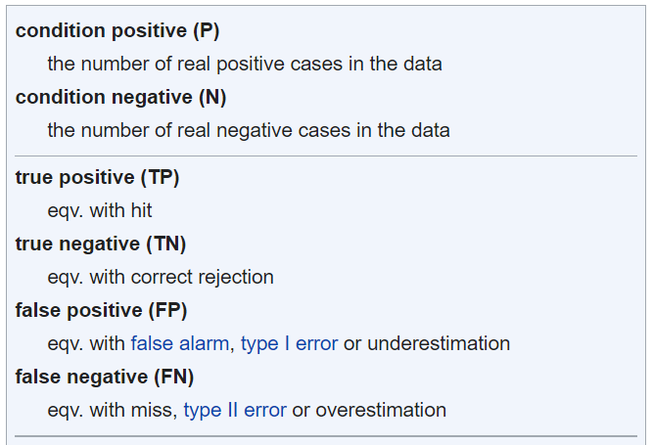


Quality of fit (supervised ML)
Given a model which makes predictions of labels ($\hat{y}$) from observations X and knowledge of the correct labels ($y$), determine goodness of fit as a single numerical value
Regression
Residual sum of squared errors (RSS)
Mean squared error (MSE)
Root mean squared error (RMSE)
Classification
Accuracy
Balanced (class weighted) Accuracy
Precision
Recall
Matthew’s Correlation Coefficient
Source: https://en.wikipedia.org/wiki/Matthews_correlation_coefficient
Creative Commons License https://commons.wikimedia.org/wiki/File:The_Scream.jpg

Slide 7

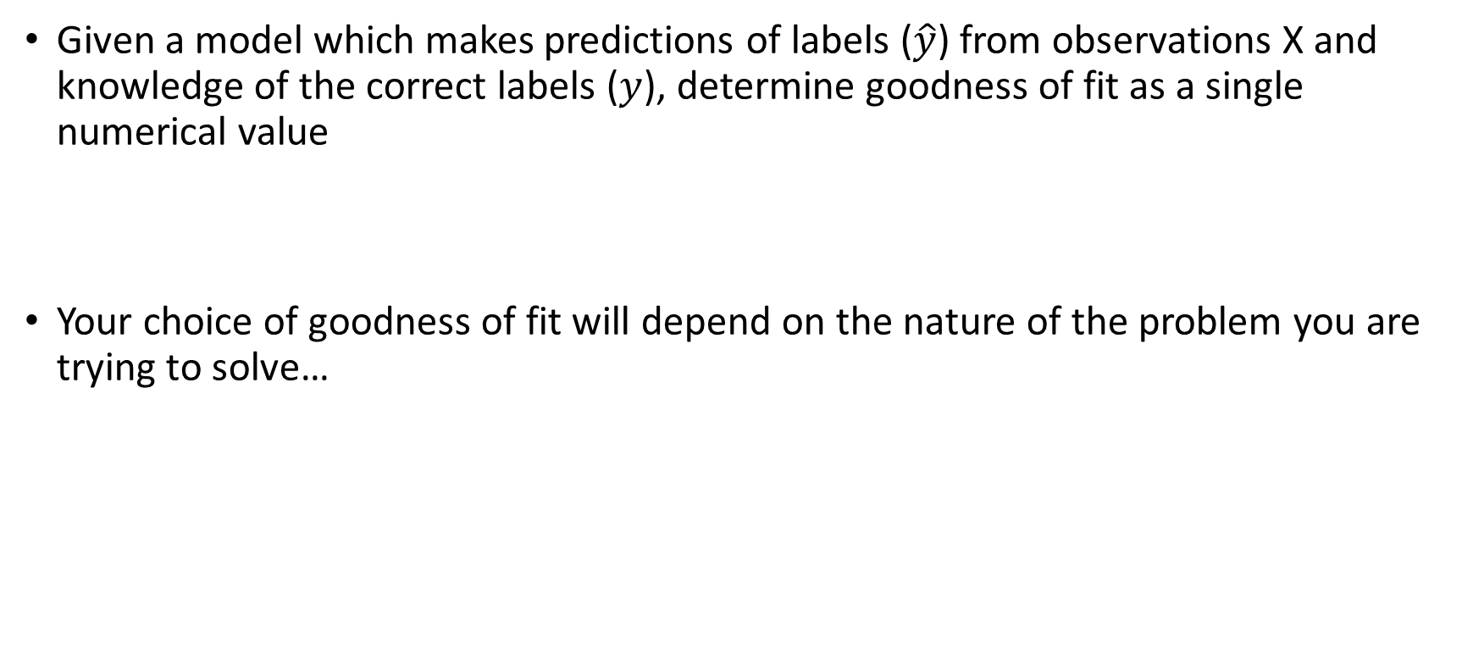
Supervised ML Quality of fit
Given a model which makes predictions of labels ($\hat{y}$) from observations X and knowledge of the correct labels ($y$), determine goodness of fit as a single numerical value
Your choice of goodness of fit will depend on the nature of the problem you are trying to solve…
Creative Commons License https://commons.wikimedia.org/wiki/File:The_Scream.jpg https://cdn.pixabay.com/photo/2019/02/19/19/45/thumbs-up-4007573_960_720.png

Slide 8



Model Flexibility & Bias-Variance Tradeoff
$$Y_{i}=f(X_{i})+ε_{i}$$
Linear terms (first order model)
$$Y_{i}=f(X_{i})+ε_{i}$$
Low order
polynomial terms
e.g. (y=x+x²+x³)
$$Y_{i}=f(X_{i})+ε_{i}$$
High order
polynomial terms
e.g. (y=x+x²+…+x³⁰)

Slide 9
ML Project Discussion - Principles
CSCE 623 Project should be related to your research (for max efficiency)
Can use techniques from ISLR but should not use neural networks or deep learning: consider the project as baseline development if you intend to try more complex ML later
May need to do “feature engineering” if starting with complex inputs (like images or signals): e.g., Histogram of Gradients for images; FFT for signals

Slide 10
ML Project Discussion: Where are you now? Risk Mitigation
Do you have a research question (or area)? What is it?
Do you have a clearly defined ML Research Question?
Given X, predict y
Given X and y, what are the important attributes of X for predicting y?
Have you started thinking about your data? Which situation applies?
Collect: Need to Collect data in the real world
Have you designed the experiment? Set up the sensors?
Simulate: Need to run a model or sim to generate data
Have you determined the experimental conditions yet?
Acquire: get data from another organization or from online
Already have data

Slide 11
ML Project Readiness – Worksheet activity
Go to the teams class notebook worksheet for project notes
Spend 5 minutes individually answering the questions on the worksheet

Slide 12
Online Datasets
If you know you wont have data available from your research area, you may want to look online:
Kaggle (https://www.kaggle.com/datasets )
Google Datasets Search (https://datasetsearch.research.google.com/ )
UCI repository (https://archive.ics.uci.edu/ml/datasets.php )
Other aggregations:
https://guides.library.cmu.edu/machine-learning/datasets
search “online datasets” or “ML datasets”
Don’t shortcut this step… consider this analogous to a “literature search” activity… dig into the data before you develop your proposal

Slide 13
Project Deliverables Schedule
Friday, 21 April: Project Proposal
Background of problem & research + initial lit review
DST for the project
Data Details
ML problem/task details
Relationship to research
Expected results / planned error analysis techniques
Tuesday, 16 May: Project First Draft
Thursday, 1 Jun: Project Video
Monday, 5 Jun: Project Final Draft

Slide 14
Break

Slide 15
Key Concepts for Linear Regression
Linear regression model
Measures of Fit
Feature relevance
How to account for Interaction Effects

Slide 16
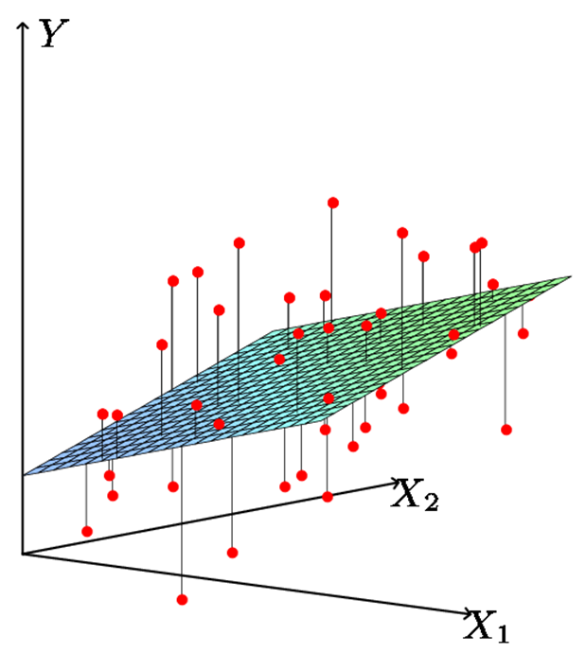
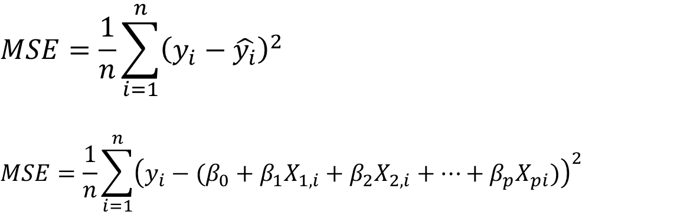
Key concepts: Linear Regression Model
$$y_{i}=β_{0}+β_{1}X_{1,i}+β_{2}X_{2,i}+…+β_{p}X_{pi}+ε$$
$$MSE=\frac{1}{n}\sum_{i=1}^{n}{{\left(y_{i}−\hat{y_{i}}\right)}^{2}}$$
$$MSE={\frac{1}{n}\sum_{i=1}^{n}{{\left(y_{i}−(β_{0}+β_{1}X_{1,i}+β_{2}X_{2,i}+…+β_{p}X_{pi})\right)}^{2}}}_{ }$$
Questions:
If we slightly change the coefficients, what happens to this (hyper) plane?
If we slightly change the hyperplane, what happens to MSE?

Slide 17
Linear Regression Measures of Fit: R²
Some of the variation in Y can be explained by variation in the X’s and some cannot.
R² is a proportion of the variance and is scale invariant
R² tells you the fraction of variance that can be explained by X.
R² is usually between 0 and 1. Zero means no variance of the response (Y) has been explained by the model. One means all the variance in the response Y has been explained (perfect fit to the data).

Slide 18
Linear Regression Feature (Predictor) Relevance
Can we be sure that at least one of our X variables is a useful predictor? [i.e. not the case that β₁= β₂= ⋅⋅⋅ = β_{p}=0]
Do all the predictors help to explain Y, or are only a subset useful?
In other words, is β_{j}=0 or not? We can use a hypothesis test to answer this question.
Feature Selection: If we can’t be sure that β_{j}≠0 then there is no point in using X_{j} as one of our predictors.

Slide 19
Evaluating the linear regression model (1/2)
Test for:
H₀: all slopes = 0 (β₁=β₂=⋅⋅⋅=β_{p}=0),
H_{a}: at least one slope ≠ 0
p predictors (features) and n observations
Compute the F statistic
When F is close to 1 there is no relationship between the response and the predictors
When F > 1, we can consider rejecting H₀
The amount above 1 required depends on n. The larger n is, the less F has to be to reject H₀
Note: p<n for this to be useful

Slide 20
Evaluating the linear regression model (2/2)
Test for:
H₀: all slopes = 0 (β₁=β₂=⋅⋅⋅=β_{p}=0),
H_{a}: at least one slope ≠ 0
Answer comes from the F test in the ANalysis Of VAriance (ANOVA) table.
The ANOVA table has many pieces of information. What we care about is the F-Ratio and the corresponding p-value.

Slide 21
Given a passing F-test, Is β_{j} ≠ 0? is X_{j} an important variable?
We use a hypothesis test to answer this question
H₀: β_{j}=0 vs H_{a}: β_{j}≠0
Calculate
If t is large (equivalently p-value is small) we can be sure that β_{j}≠0 and that there is a relationship
Number of standard deviations away from zero.
P-value
is 17.67 SE’s from 0

Slide 22
Testing Individual Variables & Conditional Relationships
Example: Is there a (statistically detectable) linear relationship between Newspapers and Sales given all the other variables have been accounted for? What about if Newspaper is the only available media?
big p-value: NO
Small p-value in simple regression
Interpretation: Newspaper doesn’t add much given that TV and Radio are used. Decision: If we can use TV & Radio, we should, but if they are not available, Newspaper still affects sales.

Slide 23
Interaction Effects
The effect on Y of increasing X₁ depends on another data feature (e.g. X₂)
Example
The effect on Salary (Y) when increasing Position (X₁) also depends on gender (X₂)
Maybe as they get promoted, Male salaries go up faster (or slower) than Females.
Advertising example:
TV and radio advertising both increase sales.
Perhaps due to synergy, spending money on both of them may increase sales more than spending the same amount on one alone?

Slide 24
Interaction effects in advertising (synergy)
Spending $1 extra on TV increases average sales by 0.0191 + 0.0011×Radio
Spending $1 extra on Radio increases average sales by 0.0289 + 0.0011×TV
Interaction Term TV & Radio together

Slide 25
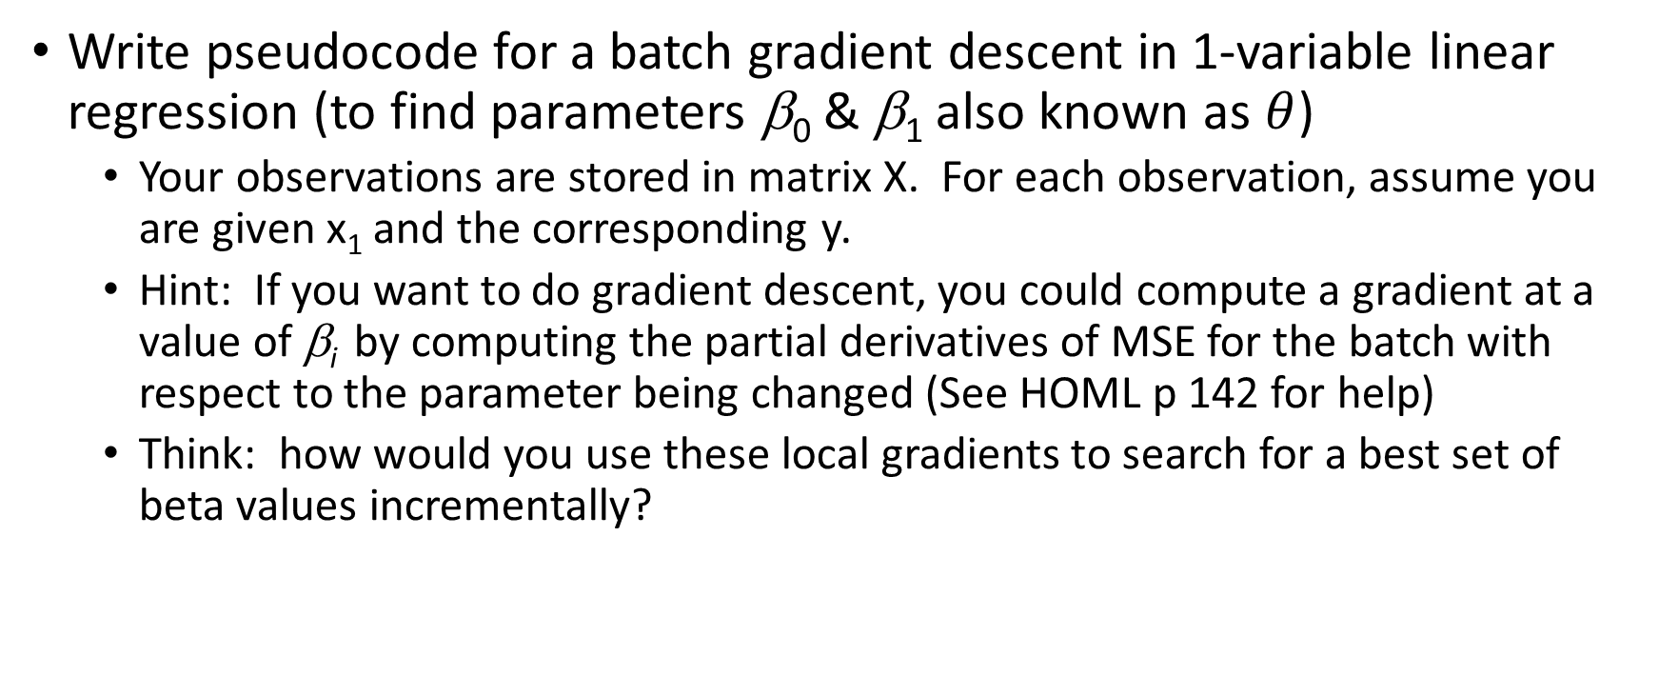
Gradient Descent Worksheet (group work, 10 min)
Write pseudocode for a batch gradient descent in 1-variable linear regression (to find parameters β₀ & β₁ also known as $θ$)
Your observations are stored in matrix X. For each observation, assume you are given x₁ and the corresponding y.
Hint: If you want to do gradient descent, you could compute a gradient at a value of β_{i} by computing the partial derivatives of MSE for the batch with respect to the parameter being changed (See HOML p 142 for help)
Think: how would you use these local gradients to search for a best set of beta values incrementally?

Slide 26
Gradient Descent Worksheet discussion
How did your team solve it?
Given the gradient, how did you ensure you were taking a step in the right direction?
What are the things to be careful about?

Slide 27
Questions

